Slide 1
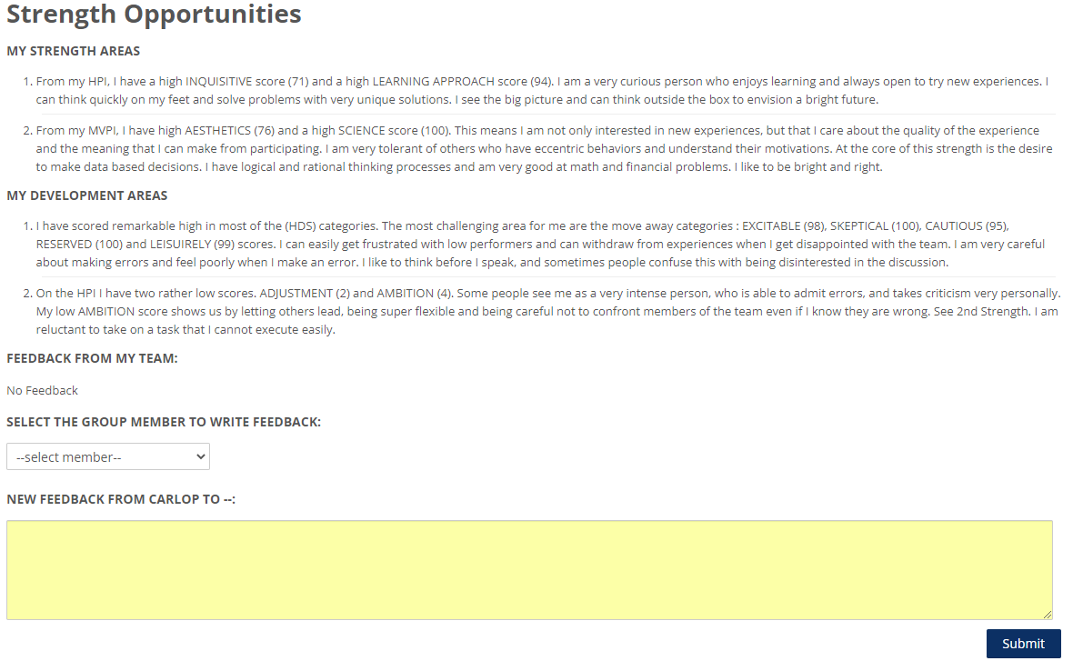
Strength and Development areas for Peer Feedback
Word count: 64
Add word count for each of the four fields require a minimum of 75 words per field. Show only in edit mode.
Word count: 88
Word count: 95
Word count: 83
Edit

